Slide 1
Come in Quietly
Take out your whiteboard & pen.
Take out a piece of paper, pen or pencil.
Have your chromebook ready to use but do not open yet.
Immigration

Slide 2

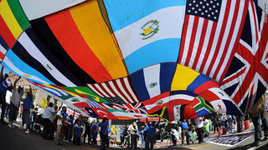
Immigration! What is it and why do it?
Objective
Obj: Identify and describe different types of immigration.
Learning Targets:
1. I will be able to identify and explain the difference between an immigrant, emigrant, and migrant.
Standard 8.6.3: List the reasons for the wave of immigration from Northern Europe to the United States and describe the growth in the number, size, and spatial arrangements of cities (e.g., Irish immigrants and the Great Irish Famine.)
CCSS.ELA-LITERACY.RH.6-8.4:Determine the meaning of words and phrases as they are used in a text, including vocabulary specific to domains related to history/social studies.

Slide 3
Prior Knowledge
Prior Knowledge
What is migration?
A common activity that involves the movement of individuals from one place to another.
What are two subcategories of migration?
Immigration and Emigration

Slide 4

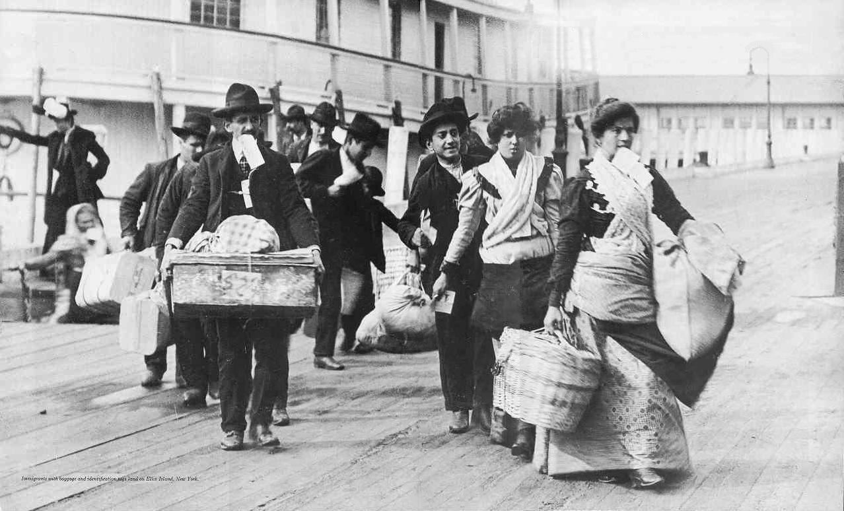
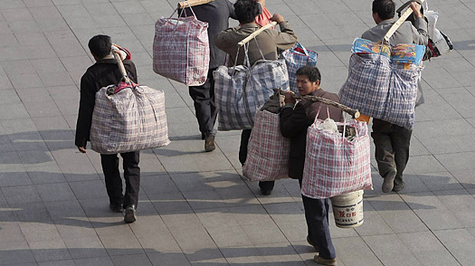
Definitions
Concept
Migrant - a person who moves from one place to another usually seasonally.
Emigrant - a person who leaves (exits) their own country in order to settle permanently in another country.
Immigrant - a person who comes into a new country to live permanently.

Slide 5
Skill
I Do
Definitions:
Migrant - a person who moves from one place to another usually seasonally.
Emigrant - a person who leaves (exits) their own country in order to settle permanently in another country.
Immigrant - a person who comes into a new country to live permanently.
A person living in Canada comes to the United States for a 2 week vacation.
This IS NOT an example of any type of immigrant
because they are not moving seasonally, or permanently to a new country.
“This is or is not an example of a(n) ________ because _______”.

Slide 6
Skill
We Do
Definitions:
Migrant - a person who moves from one place to another usually seasonally.
Emigrant - a person who leaves (exits) their own country in order to settle permanently in another country.
Immigrant - a person who comes into a new country to live permanently.
Amy waves goodbye as she leaves China to permanently live in the United States.
This IS an example of an Emigrant
because Amy is leaving to live permanently in a new country.
“This is or is not an example of a(n) ________ because _______”.

Slide 7
Skill
You Do
Definitions:
Migrant - a person who moves from one place to another usually seasonally.
Emigrant - a person who leaves (exits) their own country in order to settle permanently in another country.
Immigrant - a person who comes into a new country to live permanently.
Peter waved to his parents as they got off their plane. They had come to make America their new home.
This IS an example of an Immigrant
because Peter’s parents have come to live permanently in a new country.
“This is or is not an example of a(n) ________ because _______”.

Slide 8
Skill
Independent
Definitions:
Migrant - a person who moves from one place to another usually seasonally.
Emigrant - a person who leaves (exits) their own country in order to settle permanently in another country.
Immigrant - a person who comes into a new country to live permanently.
In Summer, Jilly moved 3 blocks from her apartment to her new house.
This IS NOT an example of any type of immigrant
because they are not moving seasonally, or permanently to a new country.
“This is or is not an example of a(n) ________ because _______”.

Slide 9
Skill
Independent
Definitions:
Migrant - a person who moves from one place to another usually seasonally.
Emigrant - a person who leaves (exits) their own country in order to settle permanently in another country.
Immigrant - a person who comes into a new country to live permanently.
Seamus moved to Alaska where he will be working for the 3 month fishing season before returning home.
This IS an example of a Migrant
because Seamus is moving seasonally.
“This is or is not an example of a(n) ________ because _______”.

Slide 10
Closure
We have learned about 3 types of Immigration.
What are the 3 types of Immigration called?
Open Google Classroom and complete CFA

